Slide 1
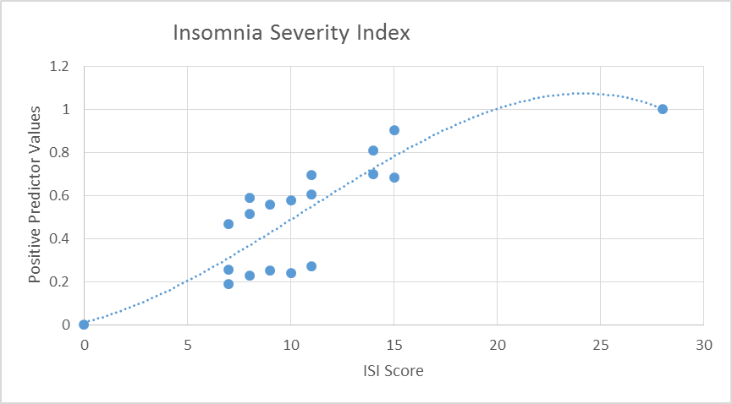
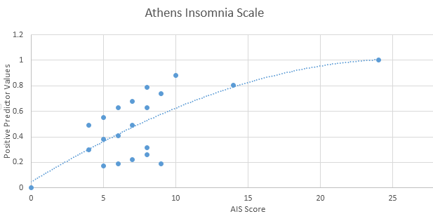
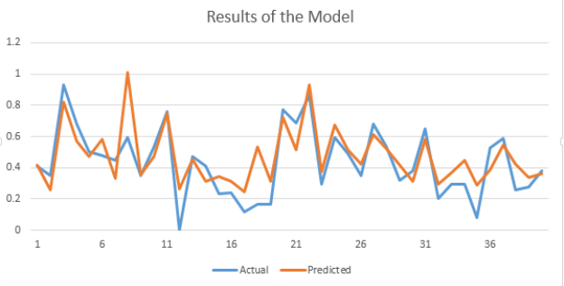
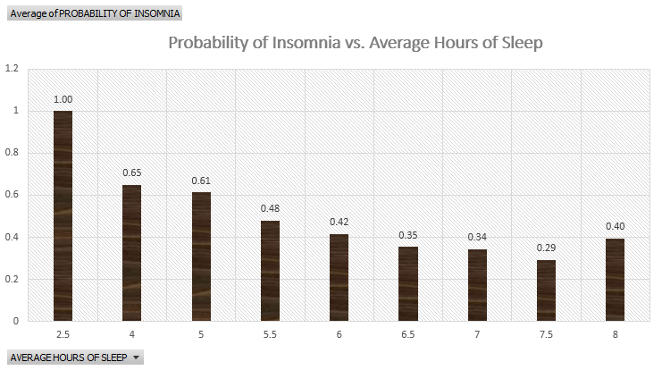
Insomnia Severity
Index Scores from Survey
Graphical Modelling for Stochastic Estimation
Find Probability of Insomnia
ISI and AIS Positive Predictive Values
Athens Insomnia Index Score from Survey
Depression Score
(DASS Survey)
Input Neuron
Hidden Layer Neuron
Anxiety Score
(DASS Survey)
Input Neuron
Probability of Insomnia
Compare
Results
&
Validate
Output Neuron
Stress Score
(DASS Survey)
Input Neuron
Hidden Layer Neuron
Input Neuron
Social Impairment Score (WSAS Survey)

